Slide 1
CipherPixelS Hybrid Steganography with LSB Encoding and AES Encryption
CAPSTONE PROJECTS
Presented By:
NARRA SAIRAM-VAAGDEVI ENGINEERING COLLEGE-MCA

Slide 2
OUTLINE
Problem Statement
System Development Approach
Algorithm & Deployment
Result
Conclusion
Future Scope
References

Slide 3
Problem Statement
This project explores a hybrid approach to data security using steganography and encryption. It hides sensitive information within digital images by modifying the Least Significant Bits (LSB) of pixel values. Before embedding, the data is encrypted using the Advanced Encryption Standard (AES) to enhance confidentiality. The system is implemented in Python with a user-friendly interface for encoding and decoding. This ensures secure, covert communication that combines visual subtlety with cryptographic strength.

Slide 4
System Approach
System requirements
Operating System: Windows 10/11, Linux, or macOS
Processor: Intel i5 or above / Equivalent AMD
RAM: Minimum 4GB (8GB recommended)
Python Version: 3.8 or above
Storage: At least 500MB for dependencies and temporary files
Image Format Support: PNG, BMP (lossless formats preferred for steganography)

Slide 5
System Approach
Library required to build the model
Numpy: for efficient pixel-level manipulation and data structuring
Cv2:Image Reading/Writing , Pixel-Level Operations and Color Space Conversion to Convert between BGR, RGB.
OS: automate file handling, manage paths dynamically, or build cross-platform tools.
Matplotlib.pyplot: for data visualization
PyCryptodome:provides a wide range of cryptographic functions like Crypto.Cipher for AES ,Crypto.Util.Padding , Crypto.Random .
Hashlib:for generating secure hash values

Slide 6
Algorithm & Deployment
step by step procedure:
Import required libraries [5]
AES Encryption : Encrypts your message with AES using a password-derived key
Embed Encrypted Data into Image using LSB:Embeds the encrypted bytes into the LSBs of an image.
Extract and Decrypt :Extracts and decrypts the message from the stego image.

Slide 7
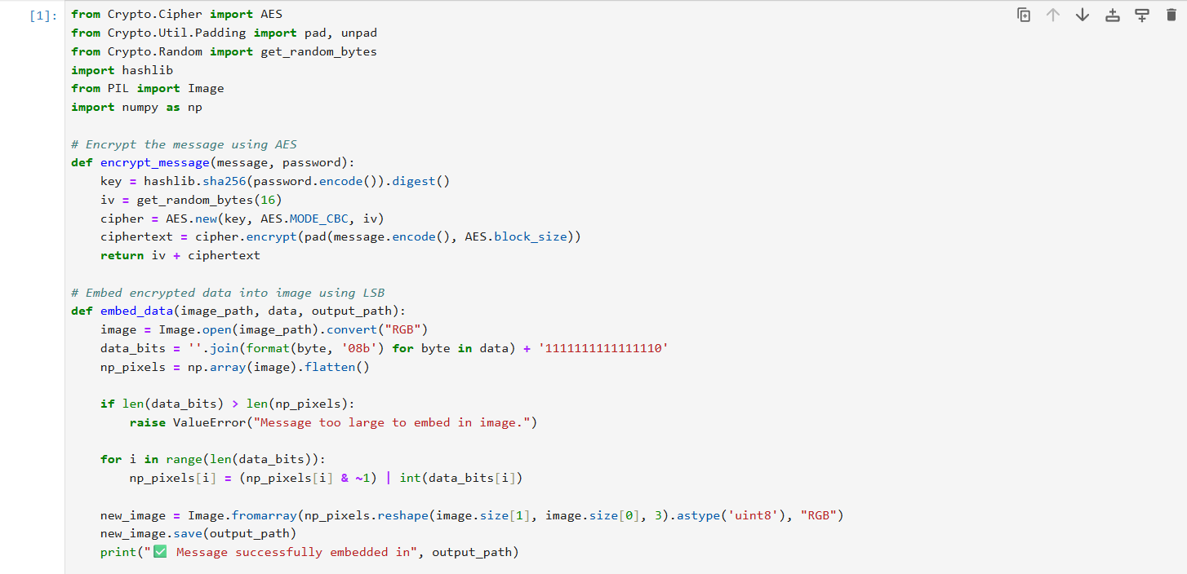
Result

Slide 8
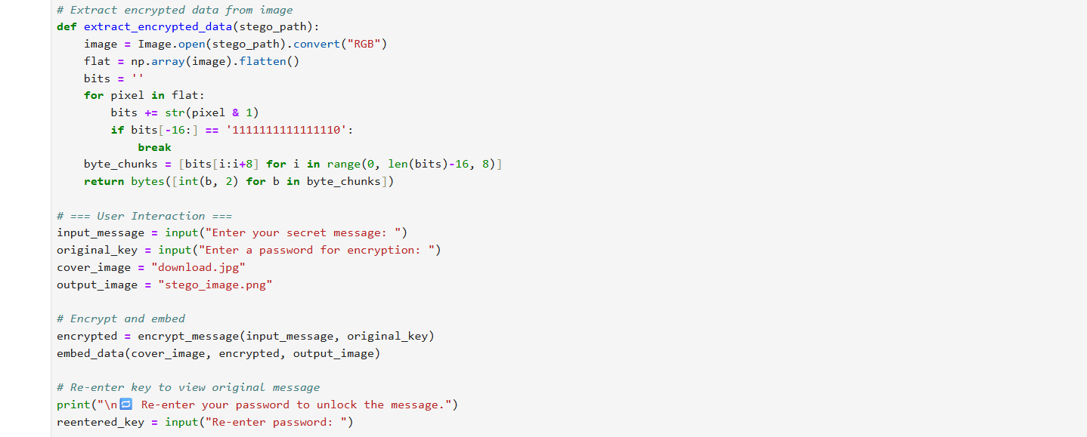


Slide 9
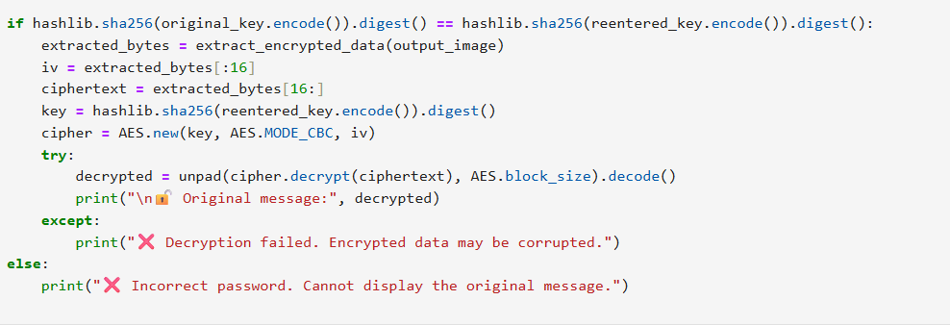
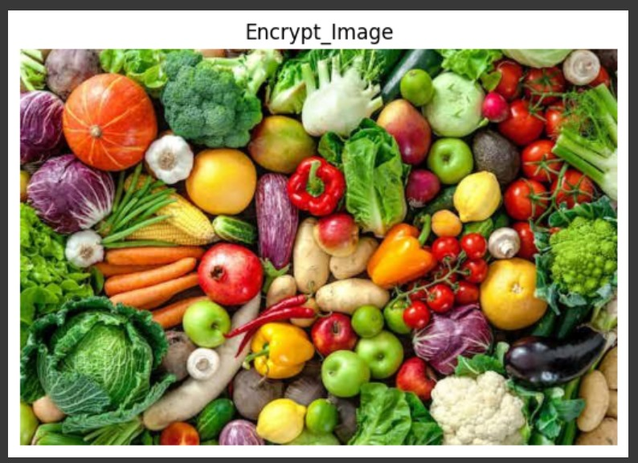
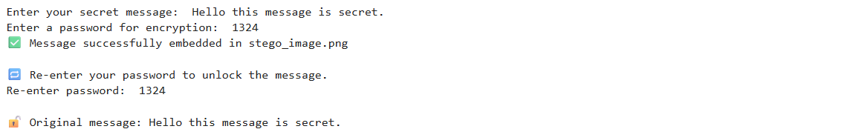
OUTPUT
Github Link:
https://github.com/narrasairam13/Steganography.git

Slide 10
Conclusion
The CIPHERPIXELS framework successfully demonstrates a dual-layered security model by integrating Least Significant Bit (LSB) steganography with Advanced Encryption Standard (AES). The implementation achieves effective and imperceptible data hiding within digital images while ensuring high-level encryption of the concealed content. This layered approach not only boosts confidentiality but also thwarts unauthorized access through combined cryptographic and steganographic barriers.

Slide 11
Future scope
Introduce adaptive LSB embedding to improve imperceptibility in complex image regions.
Extend support to audio, video, or PDF steganography for broader applicability.
Integrate secure key exchange methods like ECC for safer AES key sharing.
Explore deep learning models for steganalysis resistance and intelligent embedding.
Enable real-time data hiding and extraction, optimized for fast, practical deployment.

Slide 12
References
https://ijrar.org/papers/IJRAR24D2882.pdf
This paper outlines a secure model that integrates AES encryption with LSB steganography for hiding both text and images, forming a foundational concept
for the system..

Slide 13
THANK YOU

